Slide 1
Terrorism Data Warehouse Data Quality Assessment and Correction Plan, ETL Processes, and Loaded Instances.
Rubenia Olaska BORGE FLORES ID: 21609448
Notes:
Hello!
In this video we will discuss the Data Quality Assessment and Correction Plan, the ETL Processes, and loaded Instances for our project, the Terrorism Data Warehouse.

Slide 2
Agenda
Introduction
Data Quality Assessment and Correction Plan
ETL Processes and Loaded Instances
Conclusion
Notes:
The main points in our agenda are to explain our Data Quality Assessment, Correction Plan and ETL processes.

Slide 3
Introduction
Notes:
This project aims to build a data warehouse containing information about the global statistics on terrorist attacks around the world, and a set of social statistics summarized by country and year.
By relating data about terrorist attacks and social indicators we can explore and compare the incidence of terrorism in important social aspects such as poverty, education, and violence against women and children.
We give you the definition of a Terrorist Attack, which is the threatened or actual use of illegal force and violence by a non-state actor to attain a political, economic, religious, or social goal through fear, coercion or intimidation.

Slide 4












Data Sources
Notes:
We briefly present the sources from which we gathered the data we will load in the data warehouse.
For us this was important because a good start for data quality is to find data that comes from trusted sources. A reliable source increases our data accuracy.
On the other side, there are always challenges and unexpected situations when gathering data from different data sources.
Specially for the subject of our data warehouse which has a global scale over time, completeness of the data requires careful consideration.

Slide 5
Conceptual Model
Terrorism Data flow Model
Social Statistics data flow model
FACT constellation terrorism dw conceptual model
Notes:
Next, we review quickly our conceptual modeling phase.

Slide 6
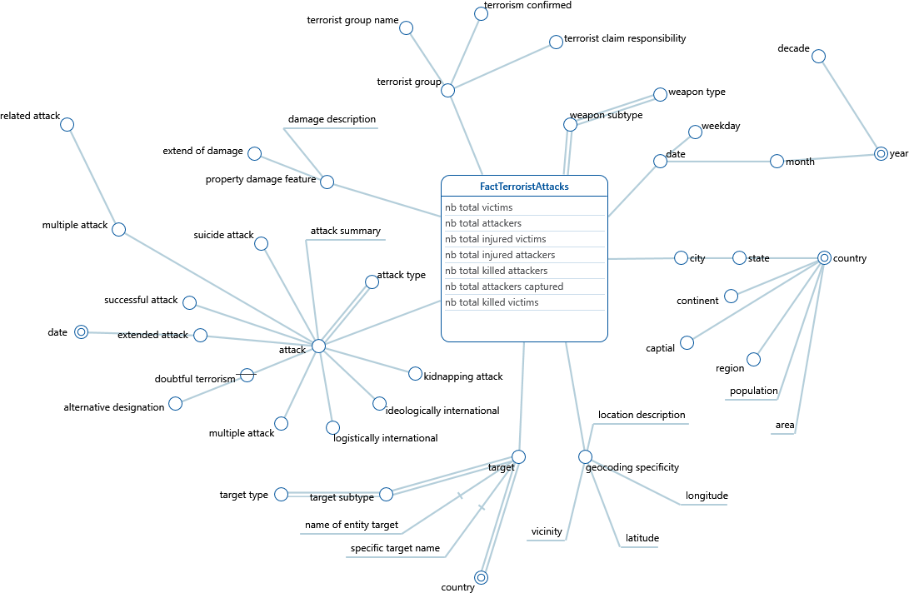
Notes:
This is our Conceptual Model for the Terrorism Dataset. We really quick present the hierarchies that will be used in our OLAP operations. The more relevant elements in a terrorist attack, attack type, weapons used, location, time, targeted victims, terrorist groups who performed the attack, etc.

Slide 7
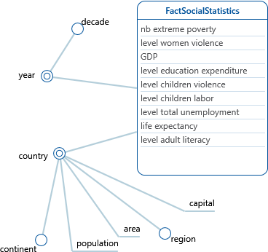
Notes:
And, next we present the DFM for our social statistics data sources. This is a merging of selected social statistics grouped by country along with relevant location information.

Slide 8
Notes:
Finally, we show you our shared dimensions that let us create our Fact Constellation. And, we now move on to present to you our Data Quality Assessment.

Slide 9
Data Quality Assessment and Correction Plan

Slide 10
Data Quality Plan
Assessment
(Or measurement evaluation)
Definition of factors, metrics, and methods)
Execution of evaluation methods
Diagnosis
Detection of anomalies, causes and weak points
Correction
Data cleaning, corrective actions, maintenance.
Prevention
Automation and generalization of corrective actions
Notes:
The Data Quality plan we will follow is the one we studied in class which has the four main phases of:
Assessment, Diagnosis, Correction, and Prevention.
The general idea is to define our quality measures, evaluate the data to detect anomalies, correct the anomalies found and finally design
and execute corrective actions to prevent data quality problems in the data warehouse.
We use the tool we learned in class, Talend Open Studio for Data Quality to create the Data Profiling of all our data sources.

Slide 11
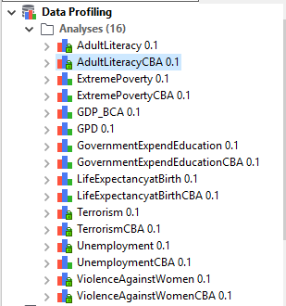
Data Profiling Assessment: Definition of factors, metrics, and methods Diagnosis: Detection of anomalies, causes, and weak points
Notes:
We start now with the Data Profiling to work on the Assessment and Diagnosis phases.

Slide 12
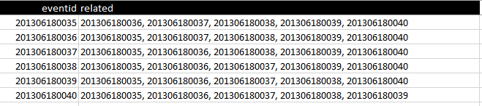
Embedded Values: Multiple Values entered in one attribute
Notes:
We start with the data quality assessment for our dataset for Terrorism. There are terrorist attacks that are related to other attacks. In our original dataset, the related attacks are embedded in one single attribute as a single string, but in reality it represents many attacks related to another.

Slide 13
Embedded Values: Multiple Values entered in one attribute
Tokenization
G: Normalize the reference to related terrorism attacks
Q: How many values need to be normalized (tokenized)? [Boolean syntactic correctness]
6034/52134 (11,57%)

Slide 14
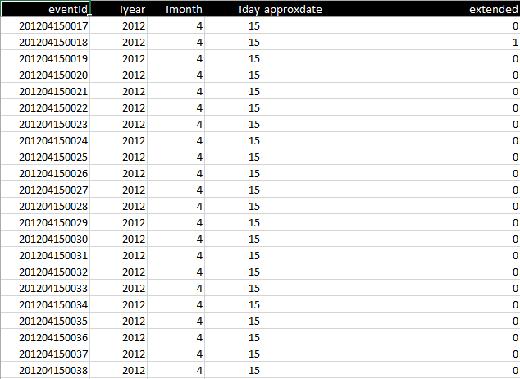
Null Values
Notes:
We next identify null values. In this case, we identify an important attribute for our context which is the approximate date in which a terrorist attack
occurred. It has null values, and we need to decide if we will discard the approximate date attribute, or we can find a way to estimate the values using statistical methods and the other attributes available or external resources. We encounter the null values problem frequently and we will consider either elimination or estimation of values on a case by case basis.

Slide 15
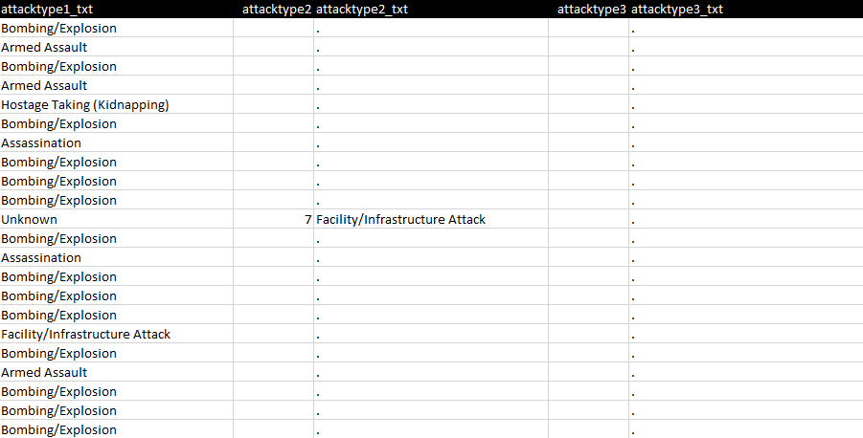
Null Values

Slide 16
Null Values
Completeness - Coverage
G: XX??
Q: How many known values do we have for the resolution of a terrorist attack?
[Boolean syntactic correctness]
1288/52134 (2,47%)
Notes:
Slide 40 3.2 DQ

Slide 17
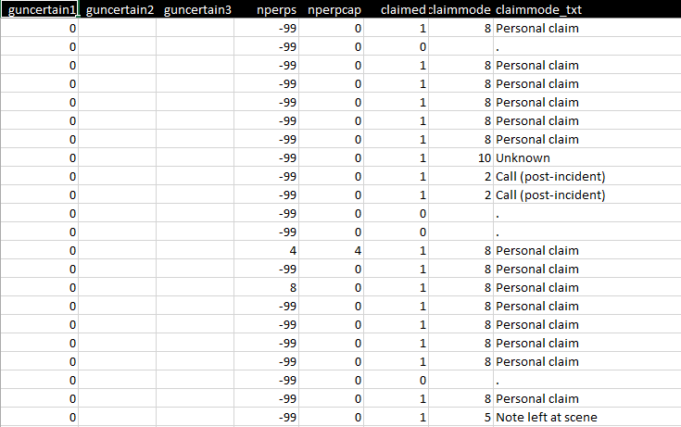
Dummy Values: -99, . , Unknown
Notes:
Dummy values is the next data quality problem we encountered. Generally, too frequent values in this case -99 can be immediately
recognized as dummy. Another quality issues are unknown values which usually lack meaning. And finally, special characters like in this case
a period ( . ) which totally lacks any meaning in this context.

Slide 18
Dummy Values: -99, . , Unknown
Completeness - Coverage
G: XX??
Q: How many dummy values do we have for the resolution of a terrorist attack?
[Boolean syntactic correctness]
1288/52134 (2,47%)
Notes:
Slide 40 3.2 DQ

Slide 19
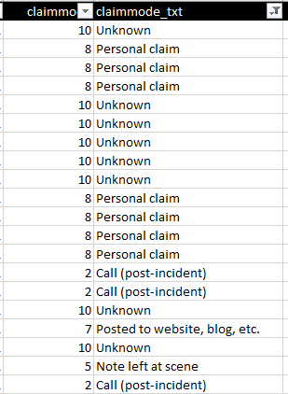
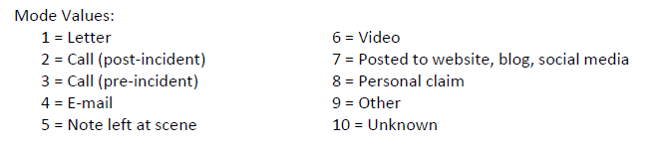
Detecting Mismembers
Notes:
Unkown no es un dummy value

Slide 20
Detecting Mismembers
Accuracy – Semantic correctness
G: Verify that every claimmode is associated to the correct claimmode_txt
Q: How many mismembers do we have? [Boolean semantic correctness]
0/52134 (0%)
Notes:
Slide 40 3.2 DQ

Slide 21
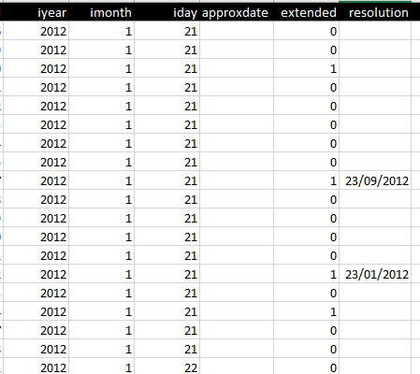
Detecting Mismembers
If extended = 1 then resolution=DATE
else resolution=NULL
Notes:
Unkown no es un dummy value

Slide 22
Detecting Mismembers
Accuracy – Semantic correctness
G: Verify that every extended terrorist attack has a resolution date
Q: How many extended terrorist attack does not have its resolution date? [Boolean semantic correctness]
1288/2981 (43,2%)
Q: How many not extended terrorist attack has an incorrect resolution date? [Boolean semantic correctness]
0/49153 (0%)
Notes:
Slide 40 3.2 DQ

Slide 23
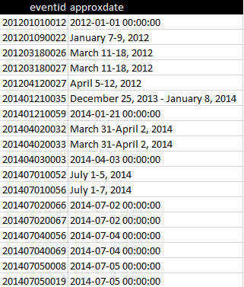
Different Data Formats
Notes:
Different Data Formats are always an important situation to be considered in data warehousing, because they are an impediment for the standardization of data needed for performing OLAP operations.
In the case of the Terrorism dataset, we find that for the non-null values of the approximate date attribute, has several types of formats, including long and short dates data formats, date ranges, and time stamps. This is for us a clear example of dirty data.

Slide 24
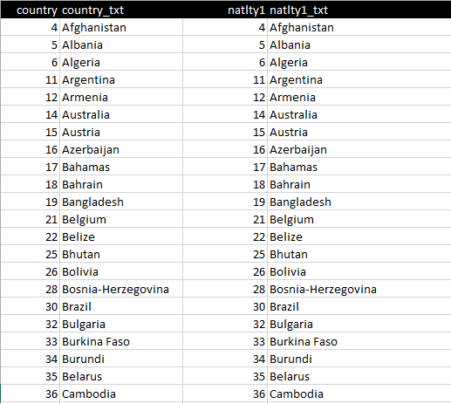
Duplicates
Notes:
We can find duplicated values between attributes and we can find duplicated values between data sources.
This is an example of our Terrorism dataset in which we find two different set of attributes country-country-txt, and natlty1-natly_txt have different names.
But, after revising their countries we confirmed that they have exactly the same values. They are duplicated in our original data source.

Slide 25
Multi-source Problems
Notes:
The following step for us, is to evaluate the data quality problems we will face when merging different data sources. We are merging datasets from databases managed by international organizations which are: The World Data Bank, the OECD organization, UNICEF, and GTD, -The Global Terrorism Database.
These are heterogeneous data sources that have different quality levels and when combining them we will encounter that they have their own controls and their own constraints.

Slide 26
Data Sources
Notes:
We briefly present the sources from which we gathered the data we will load in the data warehouse.
For us this was important because a good start for data quality is to find data that comes from trusted sources. A reliable source increases our data accuracy.
On the other side, there are always challenges and unexpected situations when gathering data from different data sources.
Specially for the subject of our data warehouse which has a global scale over time, completeness of the data requires careful consideration.

Slide 27
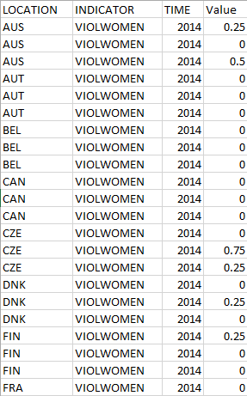
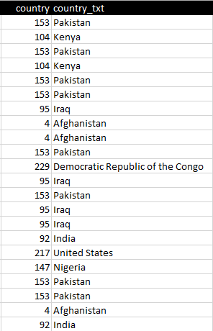
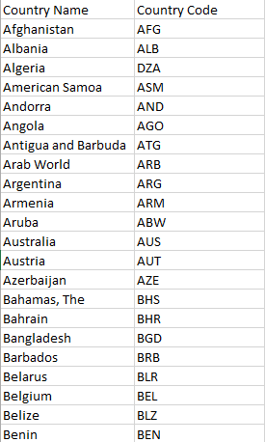
Several Data Formats
Notes:
When designing the integration of the data sources of Violence Against Women, Terrorism, and Gross Domestic Product in Dollars, we find that each source has its own codification for country names giving us the several data formats between sources quality problem. This is a case, of structural heterogeneity in which we have different representations of the same country in different databases. This creates conflicts between names and datatypes, as country codes in one source are characters while in the other source country codes are integers. Also, the first source does not have country name while the two second sources, do have country names. To solve this heterogeneity of data we use Mapping Techniques to match element parts, and transform to one single format. We will use similarity functions, to match correspondent equivalences.

Slide 28

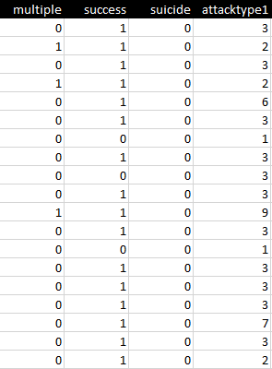
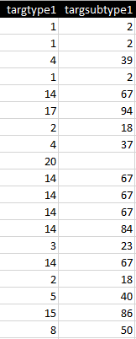
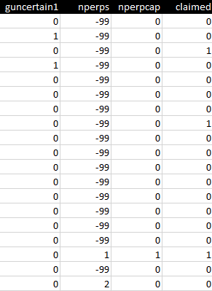
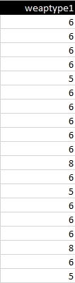
Ambiguous Semantics
Notes:
We also found out many instances in which the semantic meaning of the attributes is not clear and sometimes very confusing. This requires reading the metadata files, and evaluating on a case by case basis, which semantics are relevant or not in the subject of our data warehouse. In this case, we have different codes and to verify the semantics, we create Referentials. Based in our Referentials, we verify if the keys belong to the referential and are associated to a correct value.

Slide 29



Ambiguous Syntactics
Notes:
This is a case in which have codes for values like countries, regions, cities, streets, etc.
We need to verify syntactic correctness.
We fix this quality problem creating a dictionary or a list of valid data of a domain.
We will build a dictionary for countries, and another one for regions and verify that the keys in our data source belong to the dictionary.

Slide 30
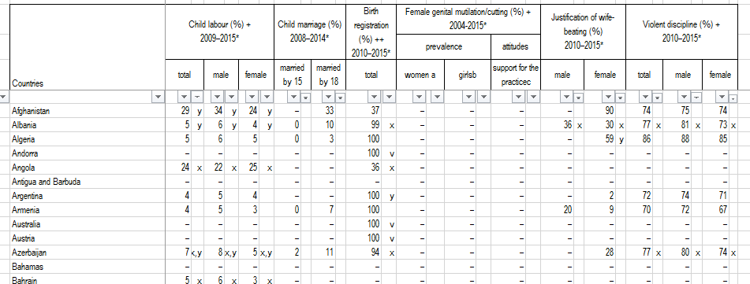
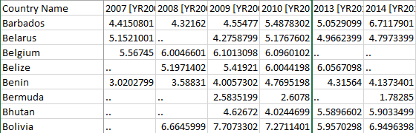
Inconsistencies
Notes:
We have inconsistencies in data formats between sources. For example, the data collected from the UNICEF data sources are group in date ranges whereas the data sources from the World Data Bank are classified yearly.

Slide 31
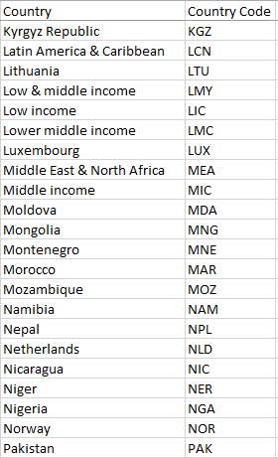
Out of Domain Data
Notes:
We continue looking for Data Quality Problems and we evaluate next, Out of Domain Data. In the column for the attribute country we have unrelated data with different aggregations for example, income levels, like low and middle income. And, also different levels of aggrupation's, like grouping Low & Middle Income.

Slide 32
Inconsistent Data
Notes:
We find also inconsistent data as in an attribute that classifies by country, we also have regions like Latin America & Caribbean, and also Middle East & North Africa.

Slide 33
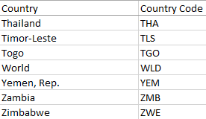
Imprecise Data
Notes:
We have a country named World in our Government Expenditure in Education data set.
This is imprecise data problem needs to be fixed as it will diminish the precision of our OLAP operations in our data warehouse.

Slide 34
Imprecise Data & Inconsistencies
Accuracy – Syntactic correctness
G: Standardize the name of the countries and remove imprecise data
Q: How many country names are out of standard? [Boolean syntactic correctness]
11/186 (5,91%)
Q: How many imprecise data should be removed? [Boolean semantic correctness]
2/186 (1,07%)
Notes:
Slide 40 3.2 DQ: This problem can be solved matching the country names against a dictionary and similarity functions. (PAUSA)

Slide 35
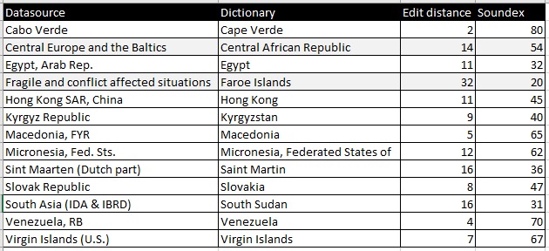
Imprecise Data & Inconsistencies
Notes:
Slide 40 3.2 DQ

Slide 36
ETL Processes and Loaded Instances
Notes:
Finally, we show the ETL Processes and Loaded Instances.

Slide 37
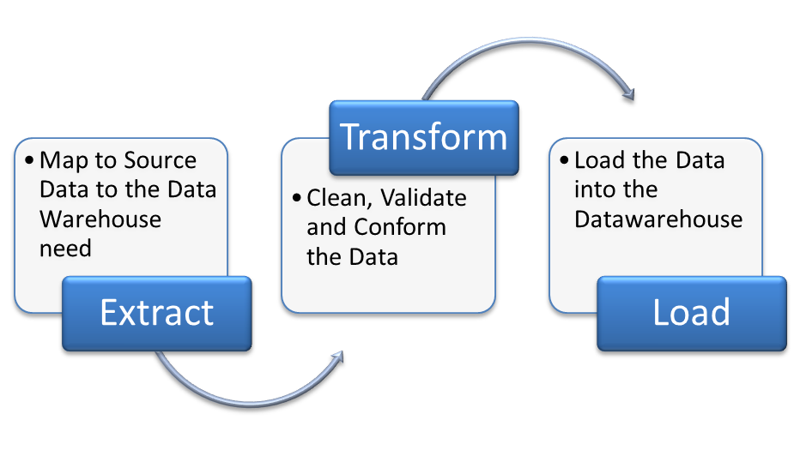
Source: Google Images
Notes:
Finally, in a very general way we describe the standard ETL process that we will follow. We already performed the Extract Phase, and mapped our external data sources to our data warehouse needs. We also performed the data quality assessment and diagnosis for all our sources, and the correction plan for cleaning data and take corrective actions.

Slide 38
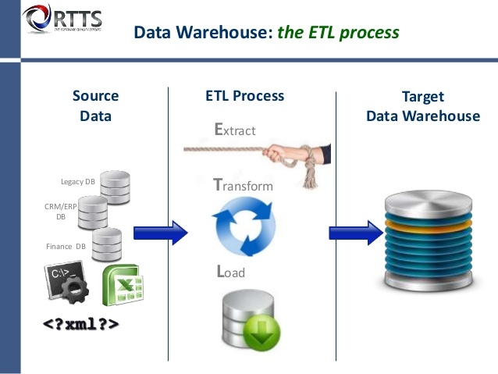
Source: Google Images
Notes:
We are currently working in the Transformation and Loading Processes that will lead us to finally load clean data in our target Terrorism data warehouse.

Slide 39
Thank you for your attention!

